Slide 1


Experience Studies Year End Report 2010

Slide 2

Content
Introduction
Experience Studies – Global Tool Set (2010)
Appendix 1 – Global Tool Set (2010)
2

Slide 3
1 – Introduction
3

Slide 4
LSC Process Workstream Overview as at end September 2009
Acquire & Contract
Service & Control
Account & Report
Steering Information
Develop Customer Relationship
Quote
Document Contract
Medical
Under-
writing
Experience Analysis
Claim Adjudication
Contract
Set-up
Account
Processing
Reserving & Reporting (FiRe)
LSC owner
DK/CT/PZ
TT
DK/CT/PZ
DOS
TT
LVE
WW & ClMkts
WW
DB
High-level alignment status
1
2
1
2
1
2
1
2
1
2
1
2
1
2
1
2
1
2
3
4
3
4
3
4
3
4
3
4
3
4
3
4
3
4
3
4
Last time:
1
2
1
2
1
2
1
2
1
2
1
2
1
2
1
2
1
2
3
4
3
4
3
4
3
4
3
4
3
4
3
4
3
4
3
4
Key:
Preparation phase, Level 3 requirements:
Very limited completion
1
Globally agreed
Level 3 process map
Organisational/ SOX controls &
KPIs recorded on map
Some or significant completion
3
Largely complete
2
Geographical differences identified
and signed off
Project program outlined
4
Notes:
4

Slide 5
Current tool and system landscape indicates significant room for standardisation
Obtain Data
Load Data
ValidateData
Analyse Data
Report Results
Store Data
Considerations
External Data
R/I data
UK is unique in using separate tools depending on whether ES is for Pricing or Portfolio Analysis purposes
Excel generally used for reporting (pivot tables) with Word and PP. Only UK uses BO.
Data not always stored – only US and Germany have a permanent store for externally supplied data
Some groupings of common toolsets e.g. UK/SA, SWE/Asia
For North America, R&D team in Fort Wayne also do ES work for Canada as well as US, so toolset is the same, but with different source systems for R/I data
US
BoF
SAS
Excel
R&D DB
Canada
multi co
Bulk
Foxpro/Lexis
Excel
Shared Drives
CA support
UK
BoF
ES Suite
BO
ES Suite
R/I data
SAS
Glean
Excel
Shared Drives
External Data
Europe NCE
LI-AS Polaris
Access Tool
R
Excel
Europe SWE
LI-AS Polaris
Stat Transfer
Stata
Excel
Shared Drives
External:Email attachments, STP, CDs, cartridges
Asia
LI-AS Polaris
Stat Transfer
Stata
Excel
Shared Drives
ANZ
i5
Access VBA
Excel
Oracle DB
Excel
South Africa
Abacus
Glean
Excel
Shared Drives
Access
Medical
MPP Tool
Excel
Shared Drives
5
While there seems considerable room for harmonising the tool landscape, ES tools Need to
be flexible in order to be able to deal with variety of products and features

Slide 6
“To be” Vision: Significantly reduced complexity: A standardised toolset
Global ES Best Practices in place to enable a global and consistent ES approach
Harmonising the underlying ES IT landscape improves the consistency of service across all ES teams.
Standard tool set significantly reduces maintenance efforts, simplifies training and enables global workload distribution with positive impact on total cost of ownership
Obtain Data
Load Data
ValidateData
Analyse Data
Report Results
Store Data
All
Global agreed Toolset
Global
ES DWH
Global
Policy
DWH
Global MM
Medical
MPP Tool
Excel
BO

Slide 7
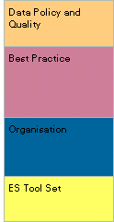



Recommendations to LSC (23 October 2009)
.
It is suggested to initiate the following initiatives/projects
- Standard ES Tool Set
- Best Practice - Organisation
- Data Policy and Quality
->Sponsors to assign Project lead and team members
->Project lead to start MDD* (module definition document) process and get project initiated subject to further LSC approval
Current ES System adaptations (e.g. Direct feed BoF ->UK ES, UK ES DWH to Oracle platform move, SAS performance improvement ) shall be done by IT Service Delivery (SED), however all adaptations need to be monitored and controlled closely so that only “need to have” changes are made as long as they are not falling under the “to be” requirements of the other initiatives
Initiate Global Policy Warehouse Project
-> Sponsors to assign Project lead and team members
-> Project Lead to draft PDD*
-> LSC to approve PDD*
Wait with Global ES Warehouse Project until decisions on Global Policy Data Warehouse and system decision in respect of Steering information MOB, UK ES and SI Hub have been taken. Any ES Warehouse solution will heavily depend on such decision
1
2
3
4
*MDD/PDD to address: Scope, Deliverables, Cost, Benefits, Approach, Schedule, Org/Resources

Slide 8
Experience Studies - Projects 2010
1
1
Global ES Toolset
Define list of selection criteria for assessing ES tools
Assessment of applications in use and potential further solutions against criteria
Select a preferred tool-set for ES
Propose Implementation plan for global ES tool
2
2
Best Practice
Establish and implement global best practice guidance for ES in order to establish minimum standards in data validation, data analysis, experience study methods, reporting, communication and storage.
Replace existing regional ES governance documents.
3
Data Quality Labeling Framework
3
Project integrated and mandated by the Global Policy Data Warehouse Project
Framework for determining data quality of seriatim policy data
Plan for technical implement of a data quality labels
Plan for global monitoring data quality
Implementation data quality labels in key policy DWH
Global policy/strategy on collecting and processing of seriatim policy data
4
4
Gobal Data Policy
Project Start TBD
Review requirements for collecting and processing seriatim policy data globally. Adjusted SR policy/strategy wrt to data requirements in standard treaty wording accordingly.

Slide 9
2 – Experience Studies Global Tool Set
ES Tool Set - Project Overview
ES Tool Set - Approach
ES Tool Set - Evaluation
ES Tool Set - Preliminary Recommendation
ES Tool Set - Current Status
ES Tool Set - Appendix
9

Slide 10
Project Overview
1
Global ES Toolset
Scope & Deliverables
Define list of selection criteria for assessing ES tools
Assessment of applications in use and potential further solutions against criteria
Select a preferred tool-set for ES
Propose Implementation plan for global ES tool
START: Analysis of ES tool sets in use and available on market
STOP: Recommendation of preferred tool set and approach to transitioning
IN SCOPE:
Analysis of existing tool sets (Stata, SAS, Glean, Bestandsmonitoring, etc.)
Analysis of commercial software not yet in use at Swiss Re
OUT OF SCOPE:
Implementation of standard ES tool-set
Resources
Lead:
BU: Claude Schwarz
IT: Salil Joshi
PMO: Felix Fehr
Team Members:
US: Curtis Burgener , Keith Shie
UK: Simon G Dixon
CE: Marcus Bauer and Josee Kaulich
Details
Project steps: Timeline (Preliminary)
Define list of selection criteria for assessing ES tools March
Assessment of applications against criteria April
Select a preferred tool-set for ES June
Implementation plan delivered August

Slide 11
Project Approach (Revised timelines)
Define Requirements
Data handling: usability, compatibility
Data analysis: statistical capabilities, traditional univariate ES, graduation
Stakeholders outside ES community
Test Tool Performance using a test studies
Handling capability, compatibility, usability
Short listing candidates
Desktop or server version evaluation
Impact Analysis for Change
Hardware, software – incremental costs
Training and migration efforts (IT, studies/data transformation)
Provide Recommendation
Recommend to-be tool set
Propose transition plan
Propose timelines for migration
1
2
3
4
01.01.2010
01.06.2010
01.01.2011
01.03.2011
Project focused on ES tool for key ES process steps but has not addressed underlying database questions.
This should be addressed through Policy DWH and DA projects.
11

Slide 12
Executive Summary / Conclusion
Evaluation of ES tools currently in use for ES included SAS, Stata, Bestandsmonitoring (Access VBA, ES (UK) and Glean. Alternative tools not currently in use for ES were considered but not included in review
SAS and Stata best fit ES functionality requirements due to their flexibelilty
Stata does have serious performance issues in current IT environment which may potentially be overcome in a server based solution
Impact Analysis for changing global to a global ES tool revealed that limited amount of training effort and a transition period of 6 to 12 months – (exception German Market study)
Decision for tool depending test results – including extended testing (SAS and STATA server based, both on Sun/Spark and Intel/Linux platforms

Slide 13
ES Tools – 1st Shortlisting
All tools currently used at SwissRe / considered for Evaluation:
SAS
GLEAN
STATA
ACCESS/VBA
ES SUITE
LEXIS/FOXPRO
SPlus
SPSS
R
MATHLAB
Pretium
Statistica
Current Tools in use for ES
Used by other functions at SR
Lexis/Foxpro -> In House developed tools, maintenance and development would be very intense
Splus, SPSS, Statistica -> Statistical tools with similar functionality as other tools already widely used at SwissRe and therefore would not provide value-added compared to tools where knowledge is already in house
R -> free version of SPlus; support and service questionable
MATHLAB ->Calculation engine only, not a tool that facilitates required functionalities
Pretium -> “Add on” to SAS only, not a tool
On Short List
for Evaluation
Not on
Short List

Slide 14
ES Tools Currently Used at SwissRe
-> SAS is used widely across the organization for the statistical data analysis by various functions and not just for Experience Study.

Slide 15
ES Tools Currently Used at SwissRe
Software | Total number of licenses at Swiss Re | Total number of licenses used for Experience Study
SAS | 80* | 17
STATA | TBD | 9
GLEAN | TBD | 11
-> SAS is used widely across the organization for the statistical data analysis by various functions and not just for Experience Study.
* Distribution of licenses by Corporate functions has to be established

Slide 16
Comparison Summary – Evaluation of Functionality Requirements
Evaluation Criteria | SAS | Glean | Stata / Transfer | Access/VBA | ES Suite
Data Handling | H | M | M | L | L
Usability | M | M | M | M | M
Data Analysis - statistical Capabilities | H | M | H | L | L
Data Analysis - Traditional univariate Experience Analysis | H | H | H | H | H
Data Analysis - Graduation | H | L | H | H | L
Focus on comparison: How effective can each tool fulfil evaluation criteria
SAS, Stat/Transfer are rated higher as they provide full blown statistical analysis toolset off the shelf
ES Suite, GLEAN, Access/VBA are rated lower as methods need to be programmed manually.
ES Suite, Access/VBA is rated lowest as any changes to the tool are connected with high efforts due to rigid governance and concept of the tool
SAS and Stata are most flexible tools that provide required functionalities for global ES tool

Slide 17
Evaluation Summary – Performance Test
One raw data set (2 million records) had to be imported, analysed and a predefined list of reports had to be produced by all four tools. Focus of the evaluation was on processing time and efficiency the different tools were able to handle the test data set.
Evaluation Criteria | SAS | GLEAN | Stata / Transfer | Access / VBA
Total time | M | H | L | H
Data loading | H | M | H | M
Validation | H | H | H | H
Analyses | M-H | H | L | M
Reporting | L | L | L | H
All tools identified 100% of data errors Glean and Access/VBA used lowest total time due to predefined reports Processing time for STATA extremely high due to hardware limitations Similar performance for GLEAN/SAS and Stata although none of them have standardised ES reports
Current SR workplace hardware configuration limits performance of Stata

Slide 18
ES Tools – 2nd Shortlisting
Remaining tools considered for Evaluation:
SAS
STATA
GLEAN
ACCESS/VBA
ES SUITE
Both tools satisfy requirements for a global tool
GLEAN -> No reporting functionality (just table output), fails to produce required analysis (Multivariate Analysis)
ACCESS/VBA -> Specialised tool for the Germany Market. Would need significant development and adaptation to suit for global requirements.
ES SUITE -> Specialised tool used in UK for specific ES requests. Would need significant development and adaptation to suit for global requirements.
On Short List
for Evaluation
Not on
Short List

Slide 19
Stata Performance Issue
Problem Statement:
Current SR workplace configuration limits addressable memory by STATA.
STATA loads all data in RAM and hence requires large memory space for operation. (SAS works with I/O and does not require all data to reside in the memory)
Currently there are no concrete plans to support 64 bit OS (Window 7 or Windows XP) on the Swiss Re workplace.
Possible Solution:
The vendor solution for STAT performance is to use 64 bit Operating System which would allow higher memory allocation to STATA
Test STATA as a server based solution with a POC. The cost of POC will be limited to internal efforts and minor setup costs since vendor has offered server version free for testing.

Slide 20
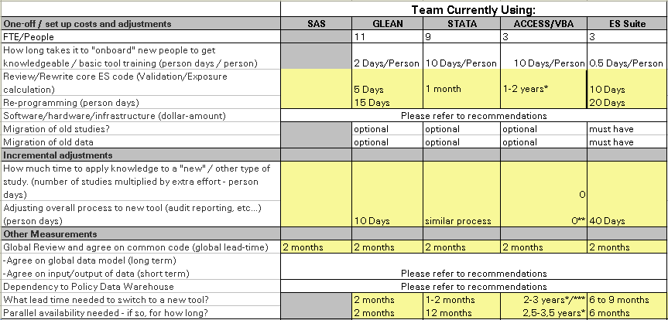
Impact Analysis
Most locations/processes could change their analysis tool quite swiftly. Considerable effort & cost involved in moving German market analysis to new platform with unclear benefits.

Slide 21
IT License Costs for running and maintaining current ES tools
Software used for ES | Region | One time license cost in CHF | Yearly recurring license cost in CHF | # of Users
SAS | US | 5000 | 2700 | 17
STATA | SWE, Asia | 3263 | 0 | 9
GLEAN | UK, SA | 4313 | 0 | 11
Assumptions
licence and recurring based on SR software catalogue/info from sourcing
Swiss Re standard SW such as EXCEL, ACCESS inlc. VB used in most locations but not listed in this analysis.
Harmonising use of certified SW for ES (i.e. SAS, Stata, Glean, SPLUS), not expected to result in any cost savings from IT licence maintenance and storage (e.g. selection of SAS would require additional investment. For STATA, cost - TBD).
Business benefits from consolidated ES studies applications and benefits from introduction of Global Policy Data Warehouse / Global ES DB not evaluated.
Introduction of SAS as a Global ES toolset would result in one time license purchase cost of 100,000 CHF and increase in annual licensing fee of 54,000 CHF.

Slide 22
Project Costs (so far)
Description | In 1'000 CHF
Internal – Biz | 120
Internal – IT | 12
External – Biz | 0
External – IT | 0

Slide 23
Decision Tree / Fit of Solutions
From the existing 8 technical solutions, 5 solutions selected for detailed assessment
Based on 4 primary evaluation criterion (Data Handling, Usability, Data Analysis, Graduation), 2 tools shortlisted
SAS
Glean
Stata
Access/VBA
ES Suite
SAS
Stata
Able to run in the existing Swiss Re workplace with large data set?
Yes
No
Alternate hosting platform (e.g. Server based) available?
SAS – Standalone (workstation based)
Yes
Yes
SAS – Server based**
STATA – Server based**
** Server based solution needs further analysis including POC work (no existing setup within Swiss Re)

Slide 24

Global ES Tool implementation options
Workplace based solution
SAS is the tool of choice at this time based on the assumption that no concrete plans to support 64 bit OS (Window 7 or Windows XP) on the Swiss Re workplace
Server based solution
Additional analysis time including investment (e.g. for POC) will be necessary
Other functions (e.g. Risk Management) within Swiss Re are reviewing server based implementation.
Since the ES tool set recommendation is for the global use, with either tools, assessment of server based solution will be useful as it inherently enable
standardization. Next slide illustrates the comparison.

Slide 25

Workplace v/s Server Solution Comparison
 | Workplace based solution (SAS) | Server based solution (SAS or STATA)
Implemention Timing | Immediately possible | Additional assessment (POC) time/effort necessary**
Timing of incurred Cost | Spread over rollout window / Incremental (benefitial with phase implementation) | During implementation readiness (one time and not spread out)
Learning Curve | Low | Medium-High
Total cost including recurring | @100,000 CHF for 30 licenses | TBD – But may be slightly higher
Ease of software configuration management and distribution* | Low-Medium | High
Ease of performance tuning and management* | Low-Medium | High
* Although each of these can be also managed with workstation based approach with well defined processes)
** POC cost will be limited to internal efforts and minor setup costs since vendor has offered server version free for testing.
The choice between Workplace v/s Server solution depends on the ‘desired timing
of the rollout of Global ES tool’. For 6-9 months timeframe, Workplace based
solution with SAS is the only recommendation feasible.

Slide 26
Implementation Options (workplace based solution)
Option Description Benefit Readiness
1
Status Quoe
Teams to continue using their current applications
none
now
2
Standard Tool
Standard tool implemented by teams, but no harmonisation /standardisation on input data format, core code and output data
ES Process standardisation
Flexible allocation of ES work and resources
Increased auditability
6-9 months
3
Standard Tool & Code
Standard tool implemented by teams with harmonisation /standardisation on input data format, core code and output data
Fully transparent and standardised ES process
Reduced maintenance of ES code
High flexibility in ES work and resource allocation
12-24 months
4
Standard Data Model
Definition of standard data model on which the ES tool infrastructure will be built. Policy DWH and ES Data Warehouse prerequisite
ES process and tools will benefit the standardised data model.
No short term benefits
2-5 years
Progressive implementation of options leads to least business interruption, while benefits can be realised short term.
Recommend option 3 as a basis for further integration at a later stage

Slide 27
Preliminary Feedback
Preliminary Feedback:
Include STATA Server based version for evaluation
Include SAS Server based version for evaluation
Additional effort with both setups:
Set up Test Server
Sample test case "German Test Study"
Sample test case "West Coast Protective Life US"
Data merging / Extend data set
Test Data Sources / Feeds

Slide 28
Experience Study PoC Server Activities/Findings so far
Sun OS/SPARC
64-bit Linux/Intel
Stata
Performance 5x slower than standard desktop and can not fulfill requirements (data volume, performance)
-> Vendor advised 64-bit Windows or Linux.
Performance slightly faster than desktop and can handle larger data sets but not all test cases.
SAS
Performance similar to standard desktop.
-> Vendor advised 64-bit Windows or Linux.
Performance 2 to 3 times faster to standard desktop, can handle all required data sets.

Slide 29
Outstanding Deliverables
Finalise Testing
Complete testing with STATA and SAS Server based version, both on Sun/Spark and Intel/Linux platform
Estimate incremental Costs
Include suitable platforms, depending on final test results
Provide Recommendation
Include benefits for recommendation
Include proposed rollout
Include proposed transition plan
Subsequent Project Work
1.
2
3
01.01.2010
01.06.2010
01.01.2011
01.03.2011

Slide 30
Appendix 1 (Global tool Set)
30

Slide 31
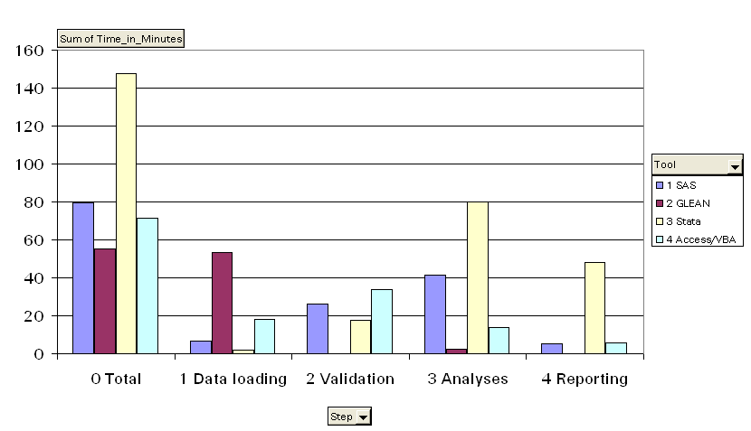
Comparison of Time Required for Test Data Set

Slide 32
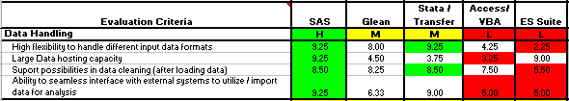
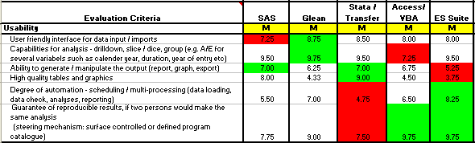
Details on Evaluation and Rating 1/3
Criteria Evaluation
Comments
SAS, GLEAN Stat/Transfer are rated higher
Relatively simple to adapt for any circumstances
ES Suite or Access/VBA are rated lower
Adaptations are connected with high efforts due to rigid governance and concept of the tool
No clear leader all tools appear to be capable of performing all requirements

Slide 33
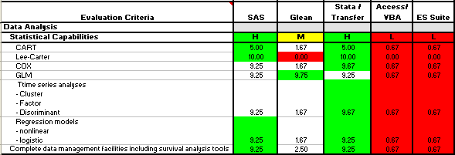
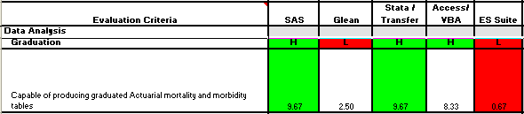
Details on Evaluation and Rating 2/3
Criteria Evaluation
Comments
SAS, Stat/Transfer are rated higher
Provide full blown statistical analysis toolset off the shelf
ES Suite, GLEAN, Access/VBA are rated lower
Methods need to be programmed manually. On ES Suite, Access/VBA this is connected with high efforts due to rigid governance and concept of the tool
SAS, Stat/Transfer are rated higher
Provide full blown statistical analysis toolset off the shelf
ES Suite, GLEAN, Access/VBA are rated lower
Methods need to be programmed manually. On ES Suite, Access/VBA this is connected with high efforts due to rigid governance and concept of the tool

Slide 34
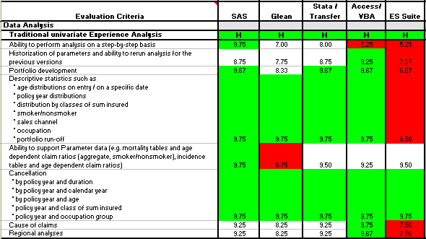
Details on Evaluation and Rating 3/3
Criteria Evaluation
Comments
No clear leader all tools appear to be capable of performing all requirements

Slide 35
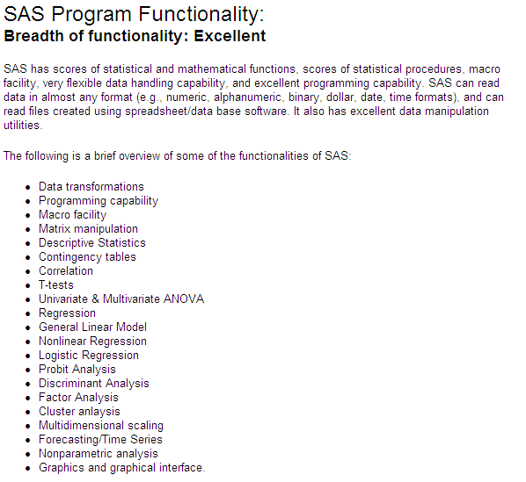
Introduction to SAS

Slide 36
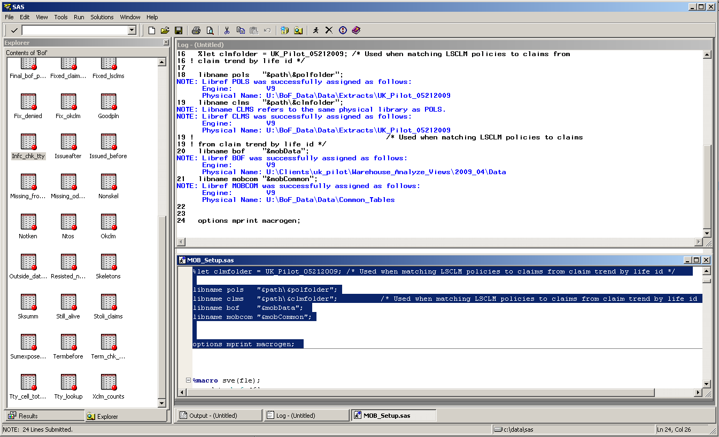
SAS user interface

Slide 37
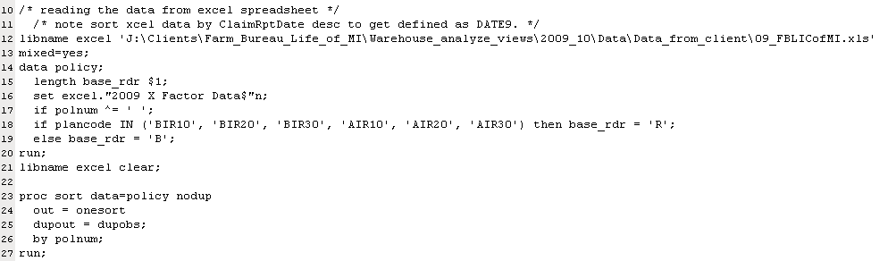
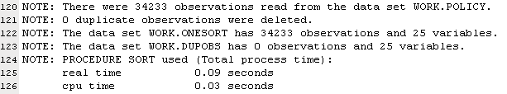
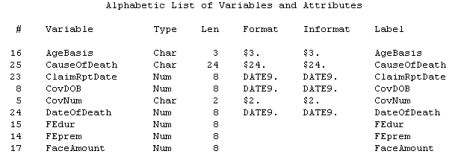

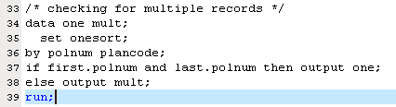
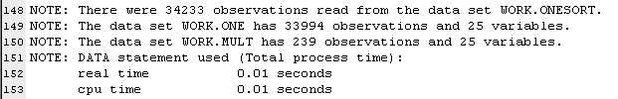
SAS read, sort, describe

Slide 38

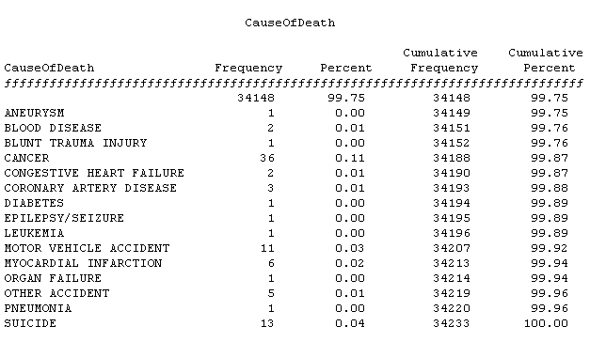
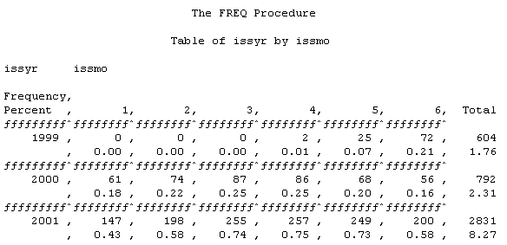



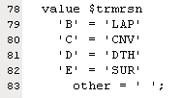
SAS frequencies, edits, lookups

Slide 39
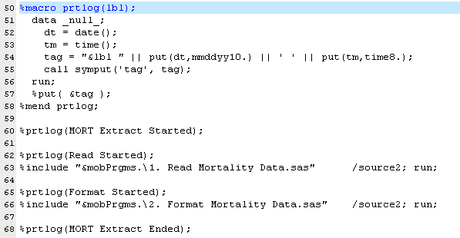
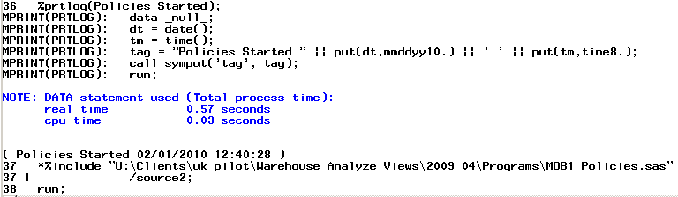
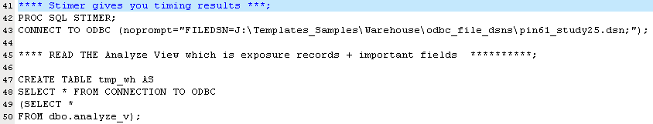

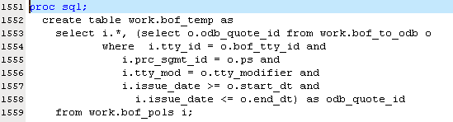

SAS macros, sql, summary

Slide 40
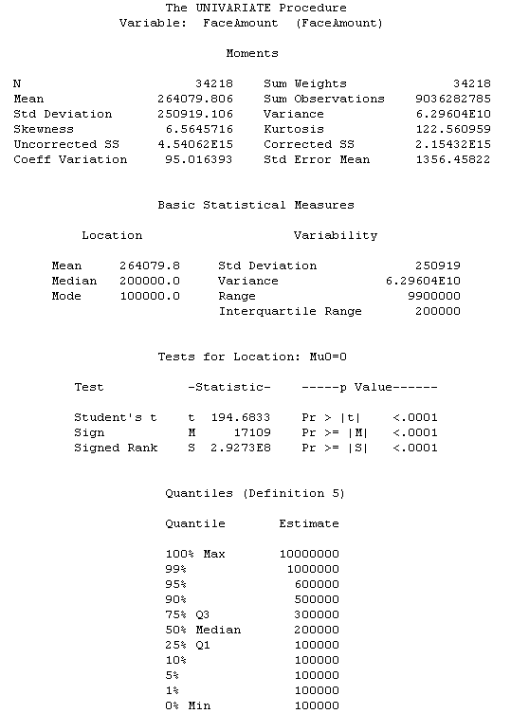
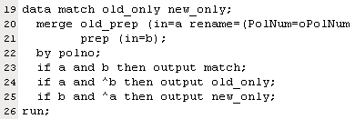
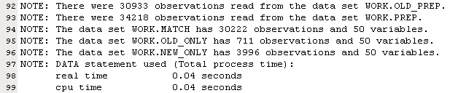


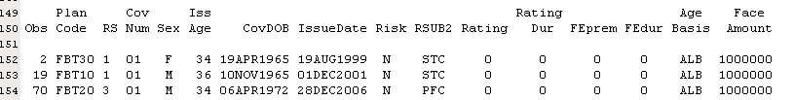
SAS merge, univariate, print

Slide 41
Introduction to STATA
Basic Functionalities:
Data import: either directly or via StatTransfer
Data management: data transformations, match-merge, append files, sort, labelling, save, ..
Basic statistics: summaries, correlations, statistical tests, confidence intervals, …
Linear models: regression, bootstrap, …
Multilevel mixed-effects models
Logistic, probit, ordinal, Poisson, negative binomial, Cox regression models
Graphics: line, bar & pie charts, multivariate graphs, survival plots, distribution Q-Q plots, …
Survey methods: summary statistics & tables, stratification, clustering,…
Survival analysis: Kaplan-Meier, parametric survival models
Time series analysis
Generalized linear modelling

Slide 42
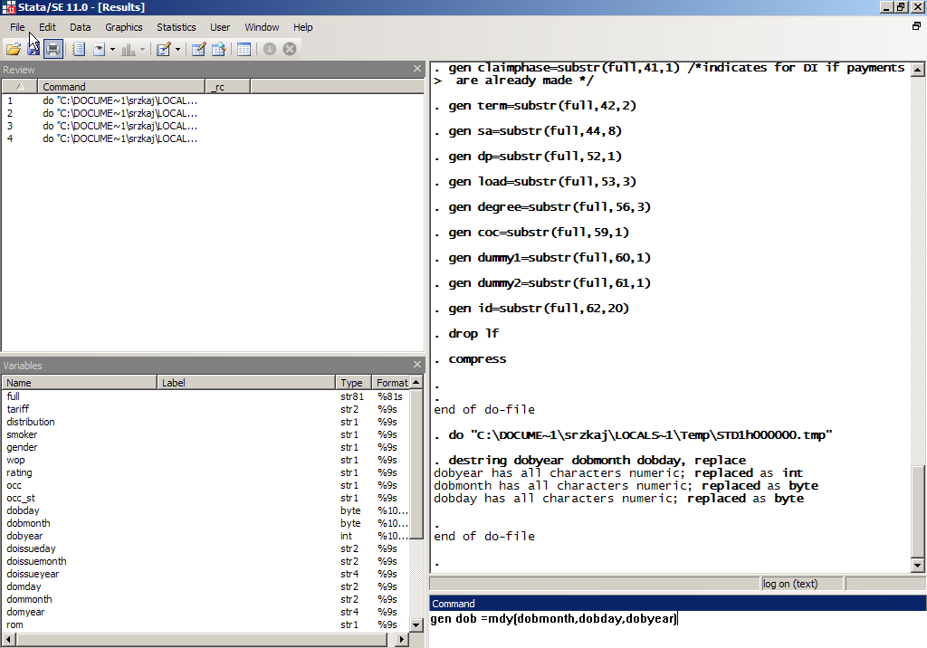
Stata: User interface – command line, variables list, review and result windows
btain Data
Load Data

Slide 43
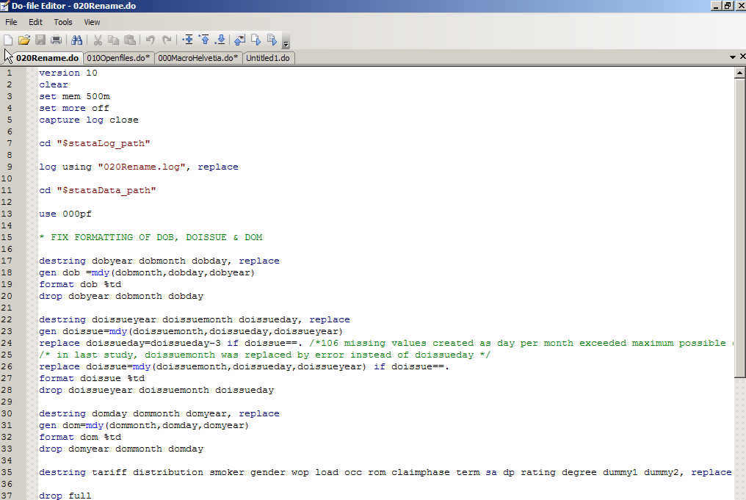
Stata: User interface – Editor window
btain Data
Load Data

Slide 44
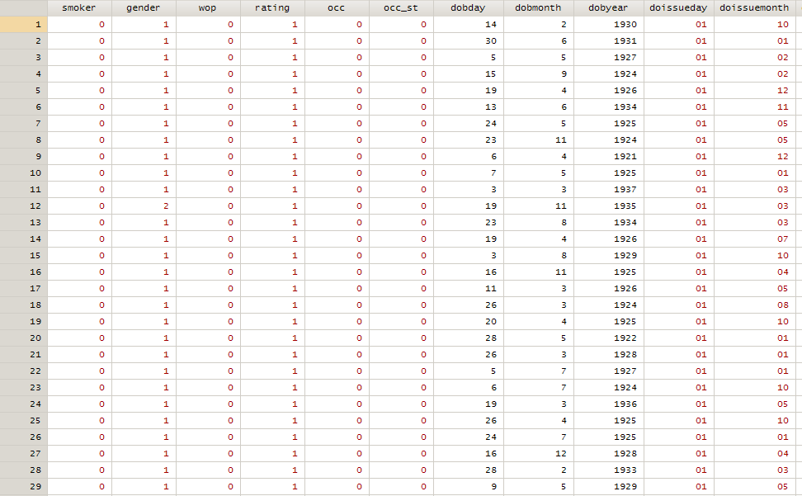
Stata: User interface – Data editor
btain Data
Load Data

Slide 45
Stata: Multivariate analysis
Cox analysis
GLM
btain Data
Load Data

Slide 46
Stata: Graphs
High quality graphics: e.g. bar charts, box plots, histograms, pie charts, line charts, survival curves,…
btain Data
Load Data

Slide 47
Introduction to GLEAN
Key Features
Actual Rates
An intuitive ‘drill down’ data analysis tool is provided. This uses data cubing techniques and charts to enable you to investigate the effect of any factors that may affect the experience such as product type, age, policy year and distribution channel.
Actual Versus Expected Ratios
Complete models of your expected rates can be set up using tables of external data. Glean can then be used to compare your actual lapse and mortality rates with the assumptions used in projection and valuation calculations. The same drill down and charting capabilities are provided as those described to analyse actual rates. It is also possible to combine the expected rates from two or more tables so that, for example, the expected mortality rates can be based on the sum of a normal mortality rate and an AIDS mortality rate.
Generalised Linear Modeling (GLM)
The Generalised Linear Modeling capability in Glean allows you to analyse your experience data using sophisticated statistical techniques. It can be used to determine which factors are statistically significant. For example, you can determine whether the lapse rates are dependent on sex, age or source of business in addition to the more commonly used factors of product type and policy year. The effect of each of the factors is estimated, normally in the form of a multiplicative model.

Slide 48
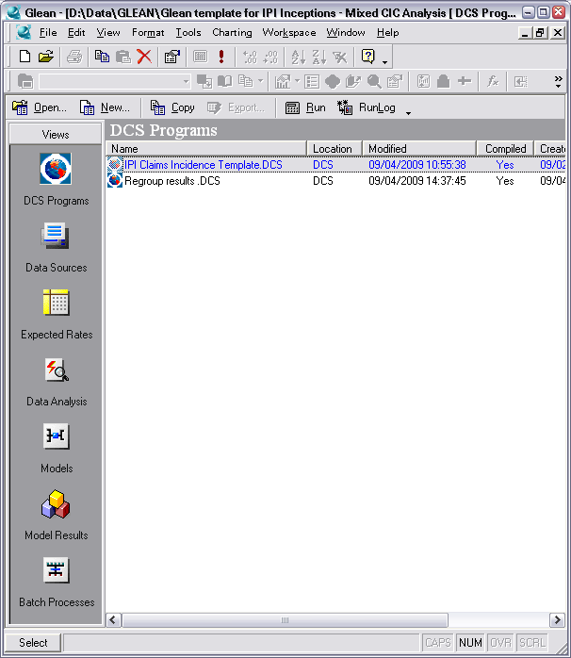
GLEAN Building Blocks
Components
DCS Programs
Data manipulation and validation. Calculation of exposure.
Data Sources
Take exposure data and define expected bases, custom calculations, data distributions and data hierarchies for reporting.
Expected Rates
Define the rates!
Data Analysis
Reports – multi-dimensional cubing and charts.
Models
Define Generalised Linear Model to be applied.
Model Results
Reports the GLM results.
Batch processes
Define any batch running and parameters.

Slide 49
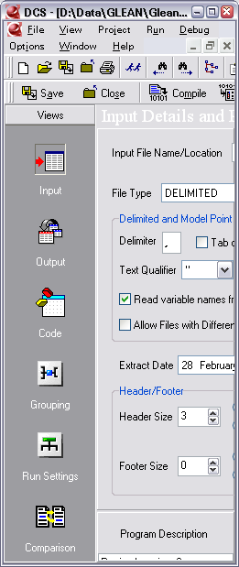
GLEAN: DCS
Define input data – fixed length; delimited; database (any ODBC data source); Prophet model point file; GLEAN data file
Amend code – data manipulation; data validation; exposure calculation; event recording.
Define output data – includes validation in addition to calculation output. Aggregated or individual records.
Define output groupings for aggregated output.
Define how GLEAN operates.
Compare different DCS.
DCS must be compiled before running.

Slide 50
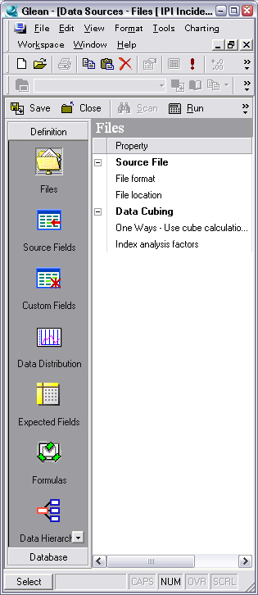
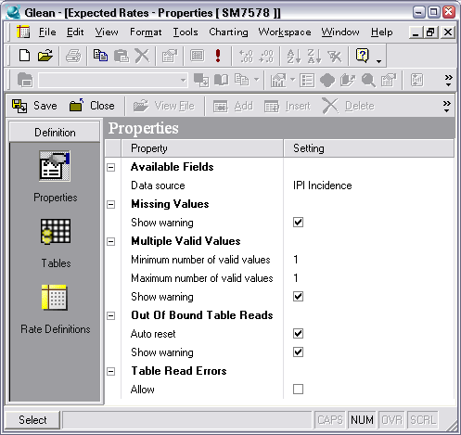
GLEAN: Data Sources and Expected Rates
Define custom data, expected and formula fields.
Define the reporting hierarchy and statistics to report.
Define Expected Rate tables and treatment.
Once defined can be run.
Rate definition of tables and criteria to apply.

Slide 51
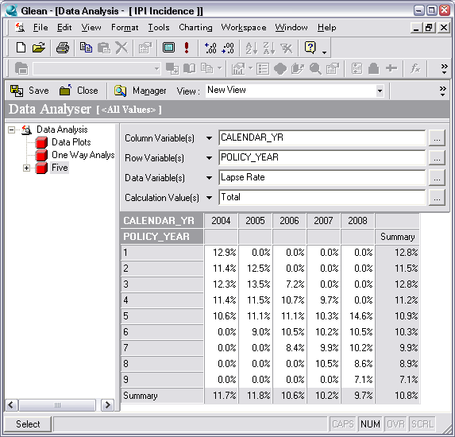
GLEAN: Data Analysis
Multi-dimensional cubing
Limited data plotting

Slide 52
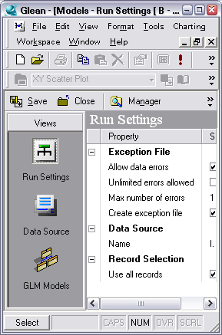
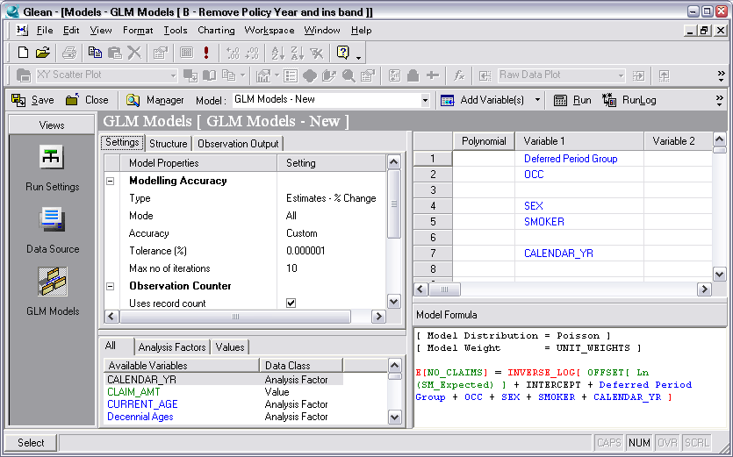
GLEAN: Models
Define and run GLM models

Slide 53
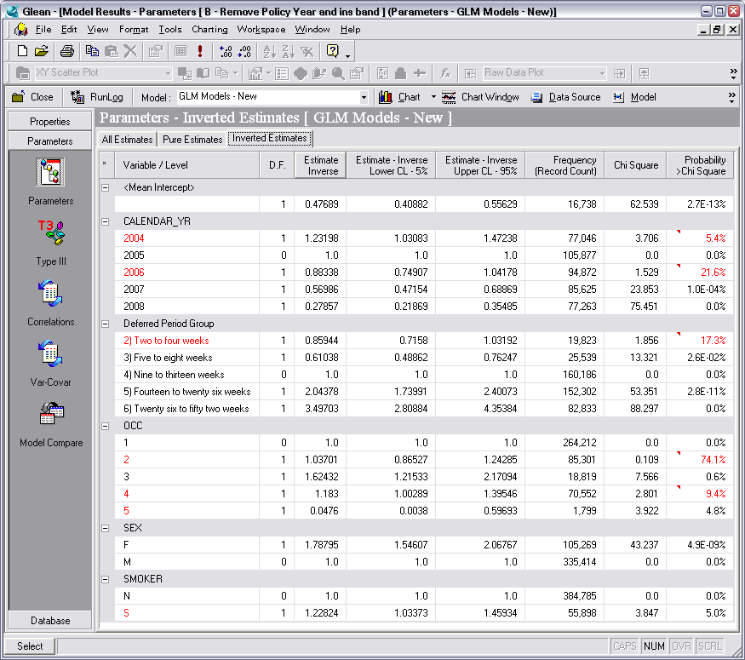
GLEAN: Model Results
Base lined against the most frequent value for each variable.
Significant factors can be identified (highlighted).

Slide 54
GLEAN: Excel interface
Add in to Excel allows for GLEAN cube and model output to be used in excel spreadsheets.

Slide 55
Introduction to ACCESS/VBA as ES Tool
Key Functionalities
high automatisation
good reporting facilities
low effort in job-training of possible users / user friendly
integrated documentation of settings for each analysis
support of pool analyses
compatibility to work with historic data
fixed data requirement

Slide 56
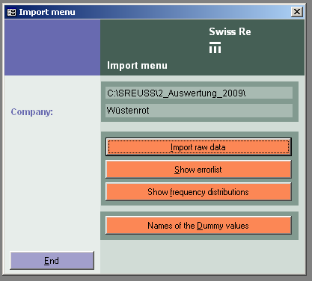
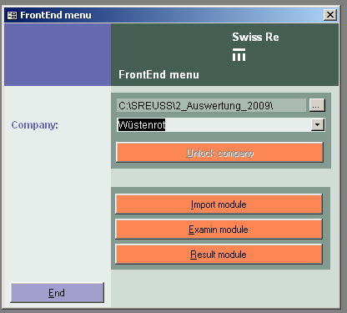
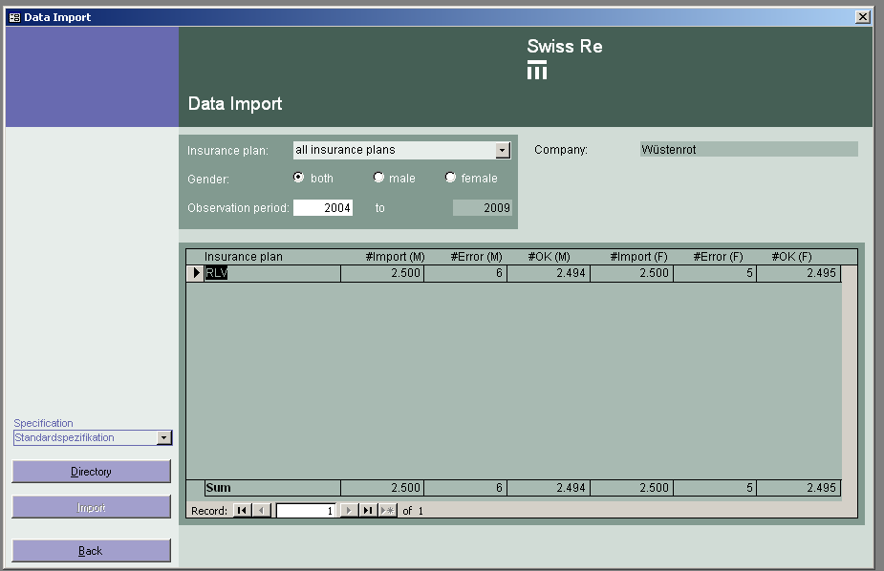
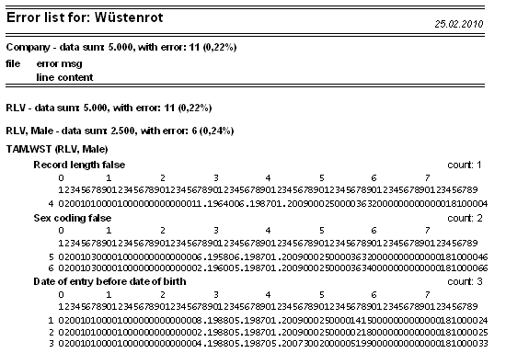
ACCESS/VBA Data Loading and Validation

Slide 57
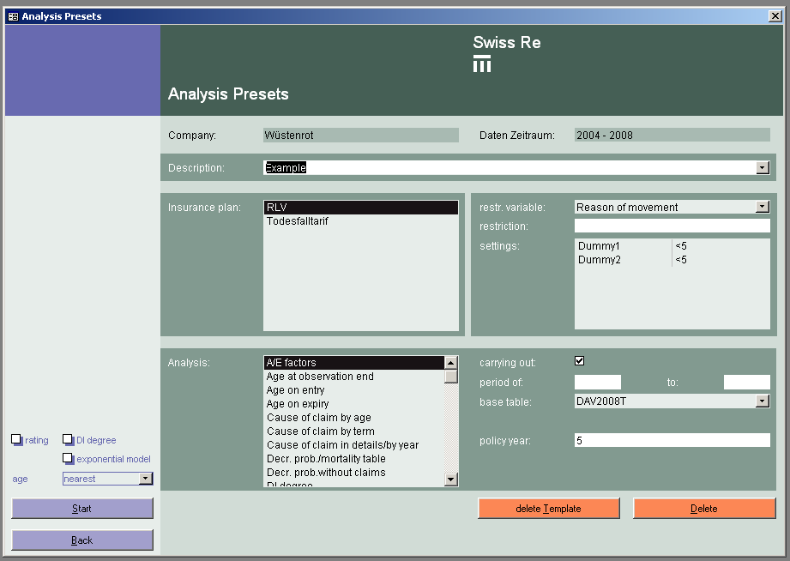
ACCESS/VBA Data Analysis

Slide 58
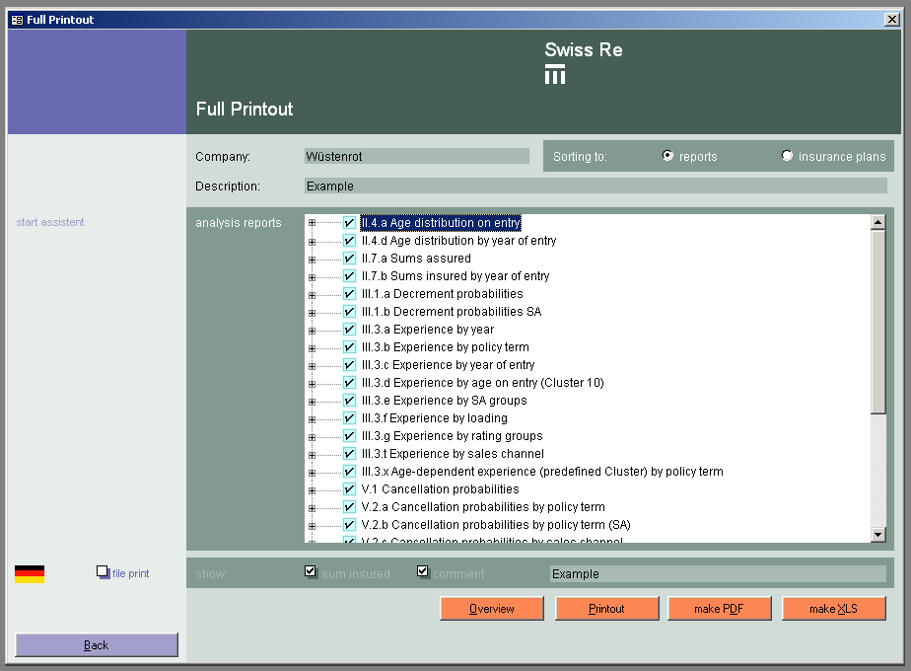
ACCESS/VBA Reporting

Slide 59
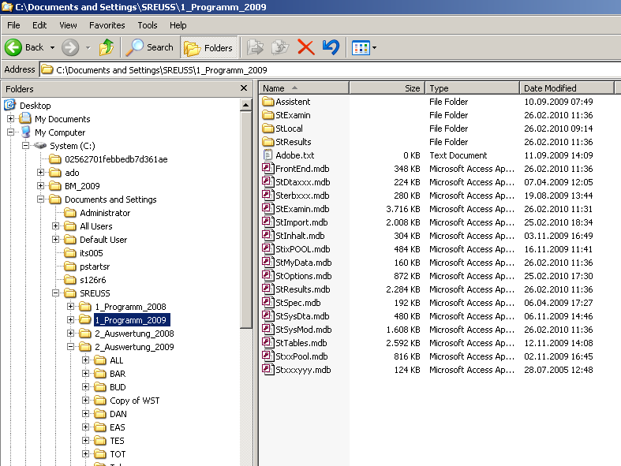
ACCESS/VBA Data Storage

Slide 60
Introduction to ES Suite
Key Functionality
Provides data manipulation, calculation and storage for Mortality and Morbidity studies.
ORACLE database with ORACLE procedures controlled by LINUX scripts. Capable of handling large volumes – 15.8 M reinsured coverages.
Separate schema available for data relating to business not reinsured – e.g. MAGNUM data.
Fully automated, supported and controlled production IT environment.
BO reporting as standard. ORACLE tables can be queried using other tools (e.g. SQL) if necessary.
Reinsured Data from BoF, presently via the monthly Legacy Interface. Automated process.
Bulk administered business can be loaded separately and added to the reinsured. For example, to provide history when converting. Manually controlled process.
Other external data can be loaded to a separate schema with identical functionality. For example, MAGNUM clients policy and claim data. Manually controlled process.

Slide 61
ES Suite - Processing: Extract, Patch and Validate
Claims

Slide 62
ES Suite - Processing: Extract, Patch and Validate
Policy

Slide 63
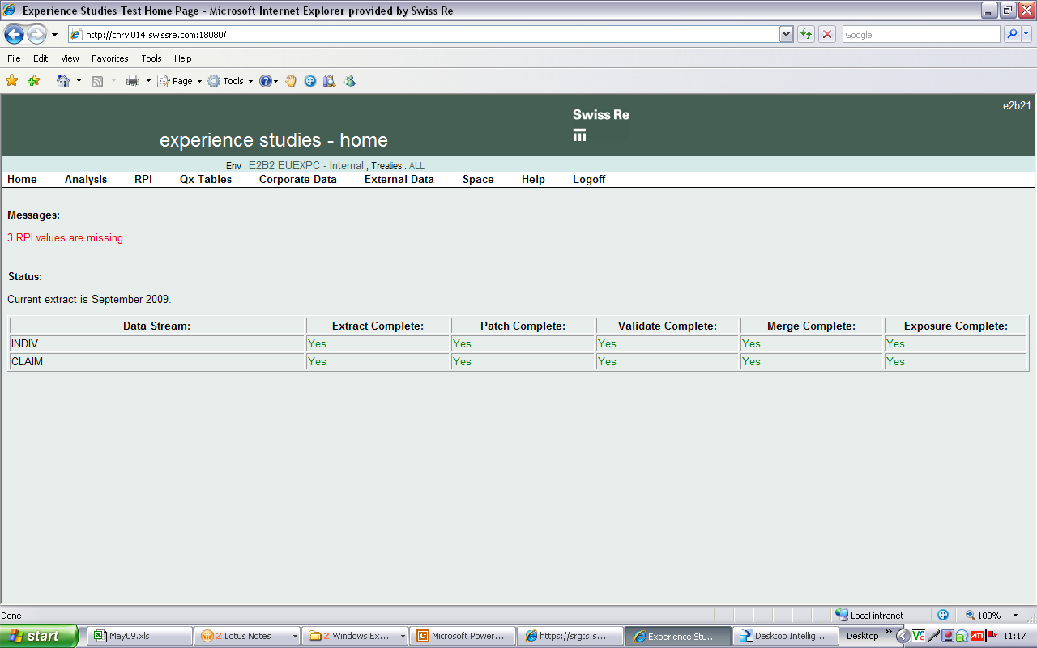
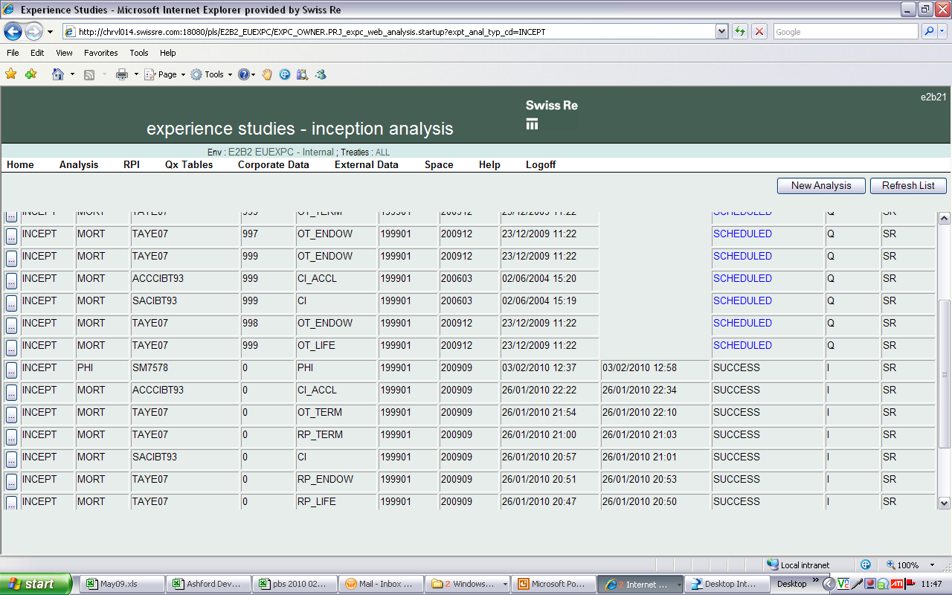
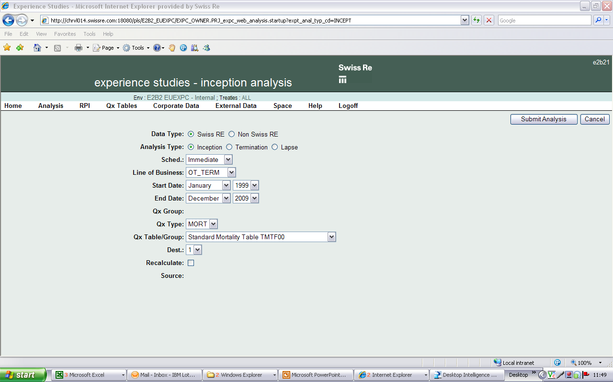
ES Suite - Analysis: Merge, Exposure and Expected Calculations
Exposure data held at coverage level
Expected data held at model point level

Slide 64
ES Suite - A/E Reporting
BoXI Reports

